Slide 1
Single Cell Data Analysis
CMM262-2019
Rob Morey
remorey@eng.ucsd.edu

Slide 2
General Workflow:
Goals:
Determine which cells are most similar to each other
Identify the features (genes) that separate the groups of cells
Workflow:
Filter for good cells and detected genes (arbitrary cutoffs)
Scale Data (TPM, z-score each gene across all cells)
Remove unwanted sources of variation (batch)
Select most variable genes (optional)
Perform PCA and identify components that capture significant signal in the data
Graph-based clustering of cells based on PCA eigenvectors
Ignoring non-varying signal in the clustering
Visualize results in 2-D space (TSNE)
Define Cell-Type specific signatures
Differential expression between each pairwise combination of clusters
Perform partition-based graph abstraction (PAGA): provides an interpretable graph-like map of the arising data manifold, based on estimating connectivity of manifold partitions

Slide 3
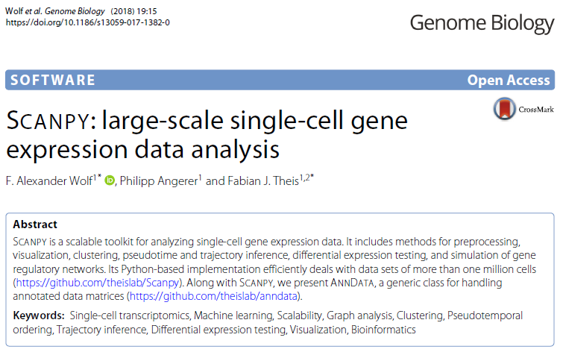

Slide 4

https://scanpy.readthedocs.io/en/latest/index.html

Slide 5
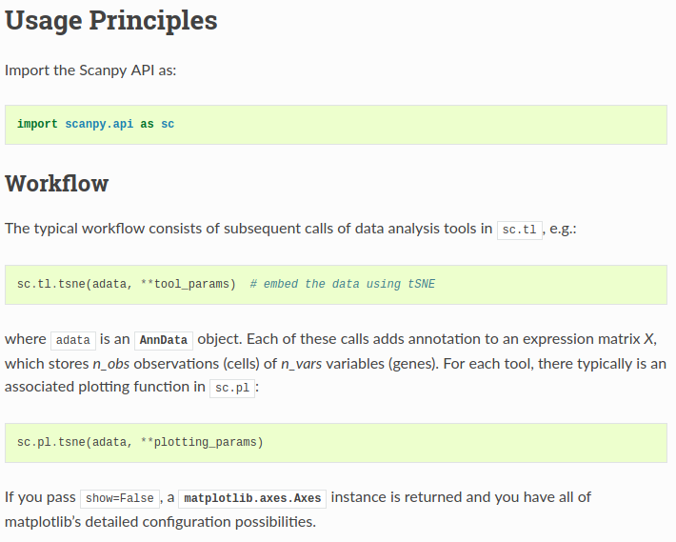

Slide 6
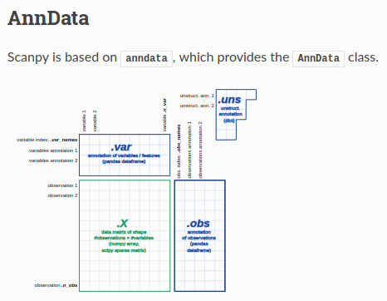
At the most basic level, an AnnData object adata stores a data matrix (adata.X), dataframe-like annotation of observations (adata.obs) and variables (adata.var) and unstructured dict-like annotation (adata.uns). Values can be retrieved and appended via adata.obs['key1'] and adata.var['key2']. Names of observations and variables can be accessed via adata.obs_names and adata.var_names, respectively. AnnData objects can be sliced like dataframes, for example, adata_subset = adata[:, list_of_gene_names].
http://falexwolf.de/blog/171223_AnnData_indexing_views_HDF5-backing/

Slide 7
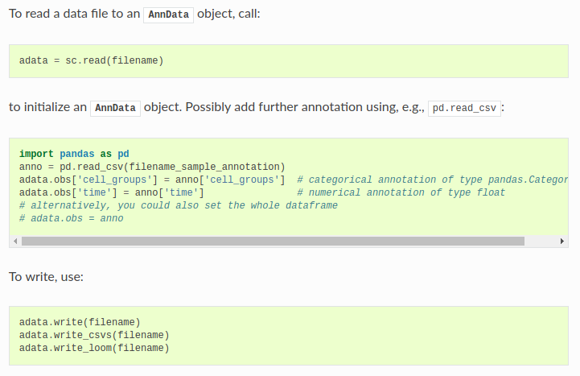

Slide 8
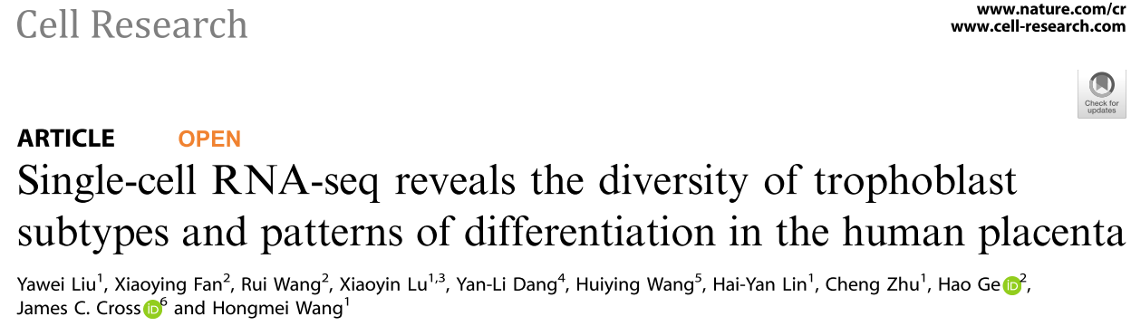
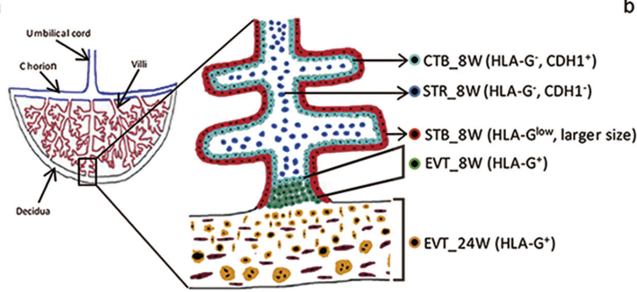

https://support.10xgenomics.com/single-cell-gene-expression/datasets/

Slide 9
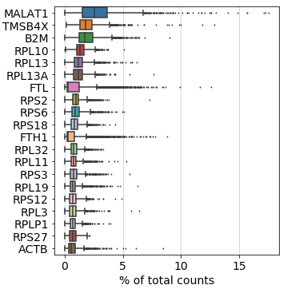
Preprocessing: Filtering for high quality cells:
Take a quick look at the genes with the highest fraction of counts in each cell, across all cells

Slide 10
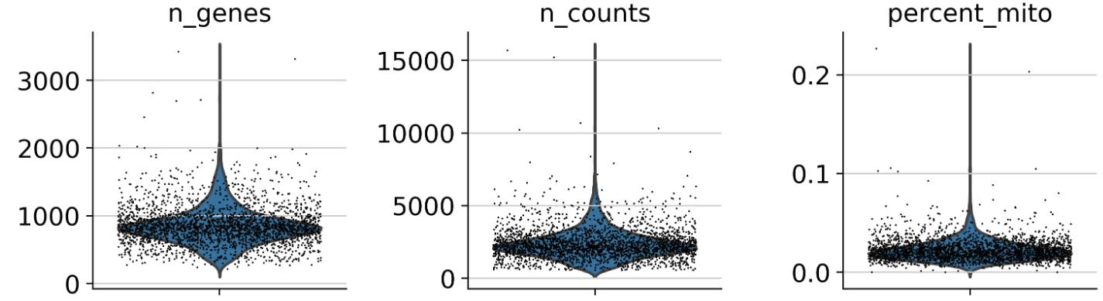
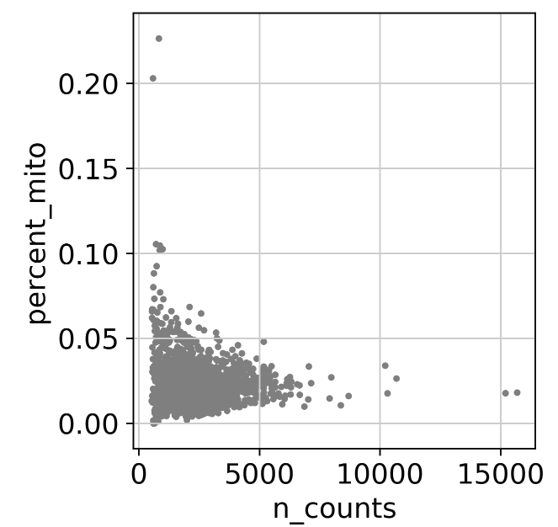
Remove outlier cells

Slide 11
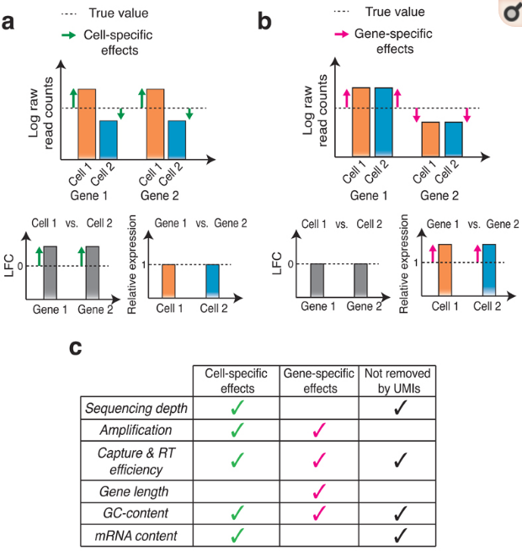
Normalize, Select variable genes, and z-score for scaling
How do you normalize for sequencing depth?
Should you normalize for sequencing depth in single cell data?
Is Length an important normalization step here?
Nat Methods. 2017 Jun; 14(6): 565–571
Notes:
Cell- and gene-specific effects in RNA-seq experiments.
(a) Schematic representation of cell-specific effects. The top panel shows a pair of cells expressing two genes at the same levels. When RNA-seq is performed, cell-specific effects introduce a bias in the estimated log-fold-change (LFC) computed on raw read counts (bottom left panel). (b) Schematic representation of gene-specific effects. The two cells and true gene levels are the same as in (a), but now gene-specific effects are shown to bias the estimation of relative gene expression (bottom right panel). In real situations, both cell-specific and gene-specific effects are present. (c) List of main cell- and/or gene-specific effects and whether these are removed by unique molecular identifiers (UMIs).

Slide 12
Normalize, Select variable genes, and z-score for scaling
How do you normalize for sequencing depth?
Should you normalize for sequencing depth in single cell data?
Is Length an important normalization step here?
Nat Methods. 2017 Jun; 14(6): 565–571
Notes:
for genes > 1000 bp in length, normalizing by length will have a detrimental effect: it will effectively under-estimate the number of reads mapped to these genes, thus leading to a reduction in power for identifying highly variable genes. The likely reason for this is that, although the SMARTer protocol is superior to the Tang protocol regarding coverage across the transcript, it still has a relatively strong 3’ bias.

Slide 13

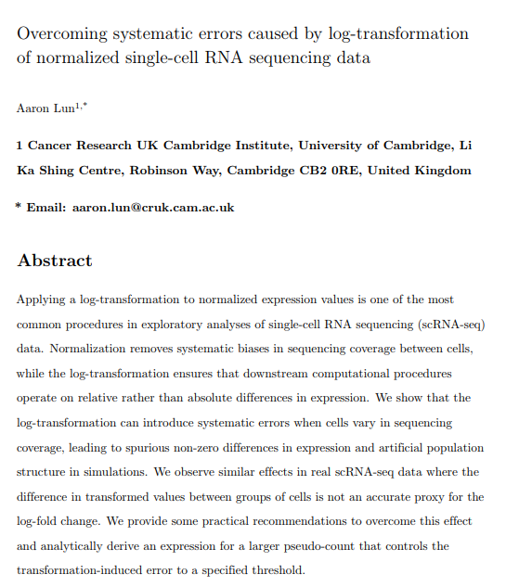

Slide 14
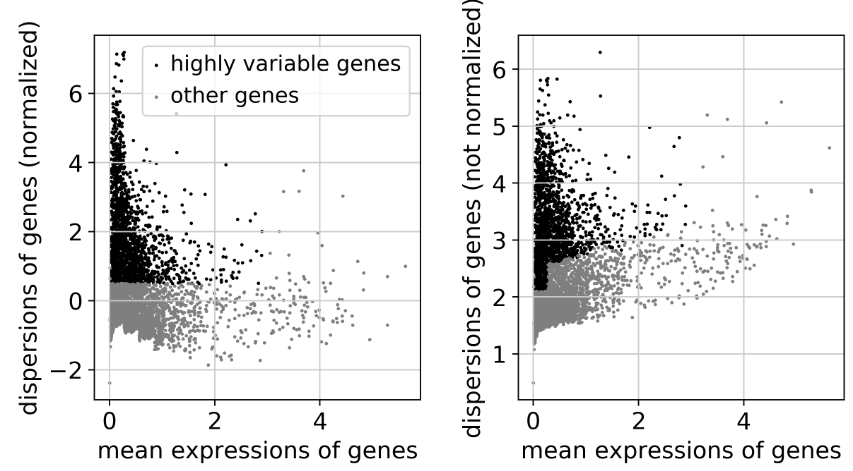
Filter for variable genes to control the relationship between variability and average expression
Notes:
calculates the average expression and dispersion for each gene, places these genes into bins, and then calculates a z-score for dispersion within each bin. This helps control for the relationship between variability and average expression:

Slide 15
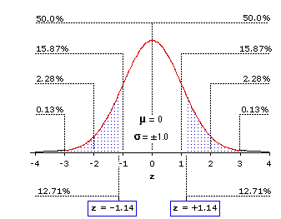
Z-score scaling for filtering in variable genes:
Z-score is the number of standard deviations away from the mean
Purpose is to scale expression of each gene relative to all the cells
What is the expected sum of all z-scores for a given gene?

Slide 16
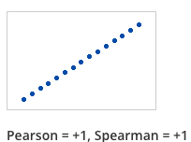
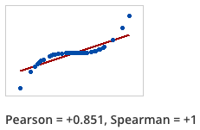
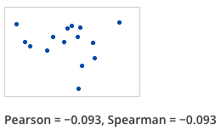
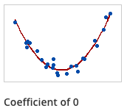
Pearson vs Spearman correlation
Pearson Correlation: For every increase in x, is there a constant, proportional increase in y?
Spearman Correlation: Rank based. If x increases, does y also increase
(magnitude doesn’t matter)

Slide 17
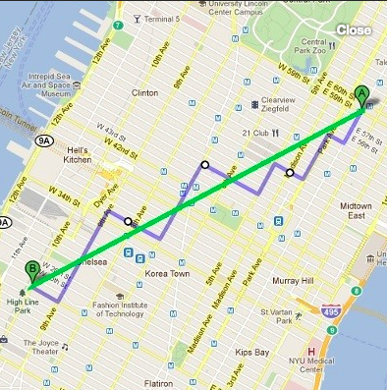
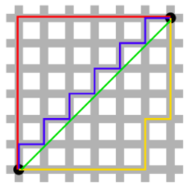
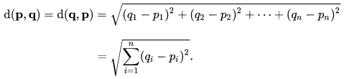
Distance metrics for “similarity” (Euclidean and Manhattan)
Euclidean: shortest distance between two points
Manhattan: distance when only moving along x or y axis
Distance is scaled to N dimensional vectors for lots of cells and genes
Two cells with 500 genes in each contain 500 distances to measure for overall similarity

Slide 18
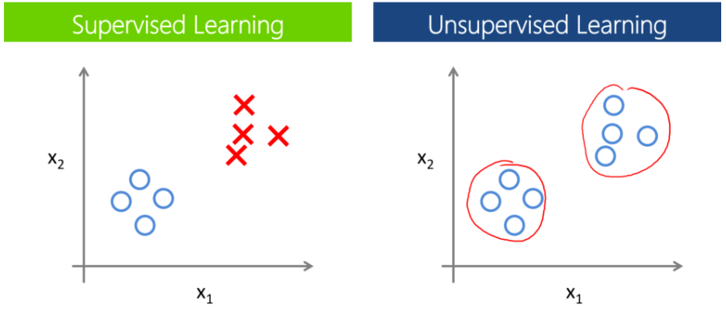
Clustering: Supervised vs unsupervised
Supervised:
Have prior knowledge of the groups
Unsupervised:
Have no prior knowledge of the data
Looking for substructure to find new patterns

Slide 19
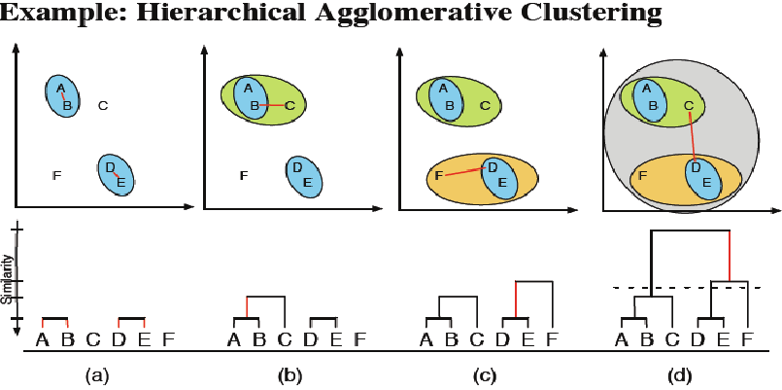
Hierarchical Clustering:
Grouping cells together based on similarity
Bottom up: Start with individual points and add most similar data points
Top down: Start with one big group, and drop out one at a time based on similarity
Cluster groups are defined based on your chosen similarity metric
https://www.researchgate.net/figure/Example-of-hierarchical-clustering-clusters-are-consecutively-merged-with-the-most_273456906

Slide 20
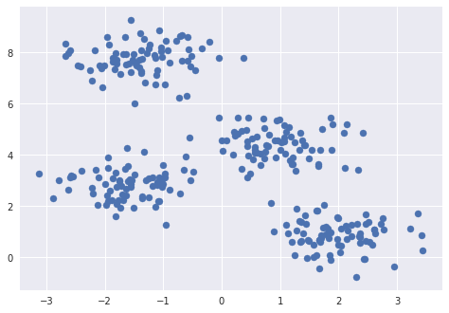
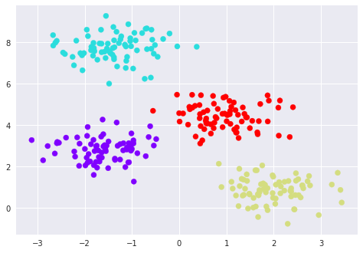
K-means clustering
How many clusters exist in this dataset?
Randomly assign points to guess the cluster centers (number of points = k)
Assign data points to the nearest cluster center.
Move the cluster assignment to the mean of each group
Repeat
http://stanford.edu/class/ee103/visualizations/kmeans/kmeans.html

Slide 21
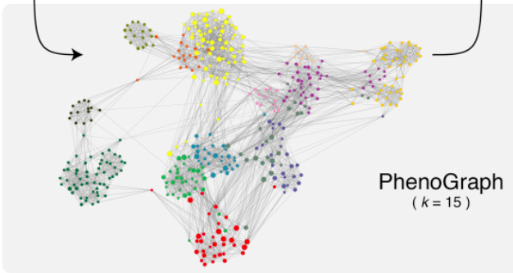
Graph-based clustering (k-nearest neighbors)
Levine et al. 2015 Cell

Slide 22
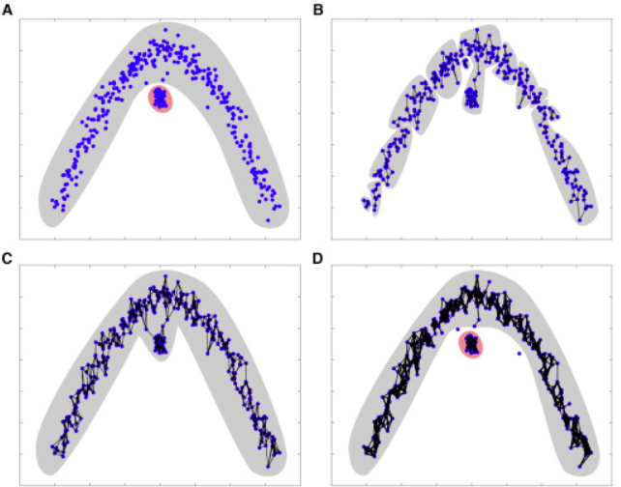
Graph-based clustering (k-nearest neighbors)
Measure Euclidian distances between cells up to K nearest neighbors (edges)
Weight of edges scales with similarity metric (euclidian distance)
Calculate “connectedness” of nodes (cells) by the number of shared neighbors
Refine densely connected modules as communities

Slide 23
k=5
Assign Modularity
k=10
Notes:
A – simulated data
B – KNN graph with k=5
C – KNN graph with k=10
D – jaccard index to assign modularity

Slide 24
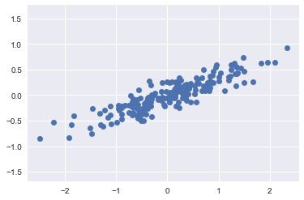
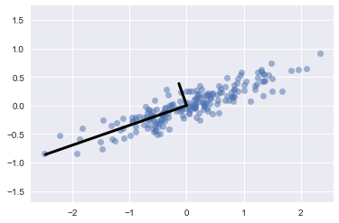
Dimensionality Reduction (PCA)
PCA:
Identifies linear components of variation within the dataset

Slide 25
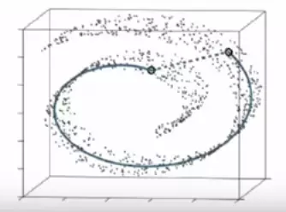
Dimensionality Reduction (tSNE)
tSNE:
Handles non-linear and sparse data very well
Preserves local relationships in high dimensional space

Slide 26

PCA and tSNE application to digits:

Slide 27
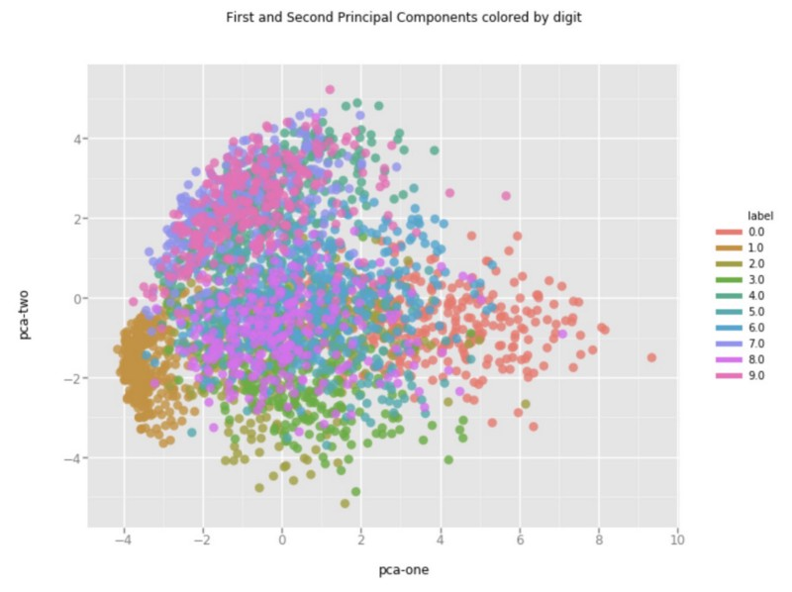
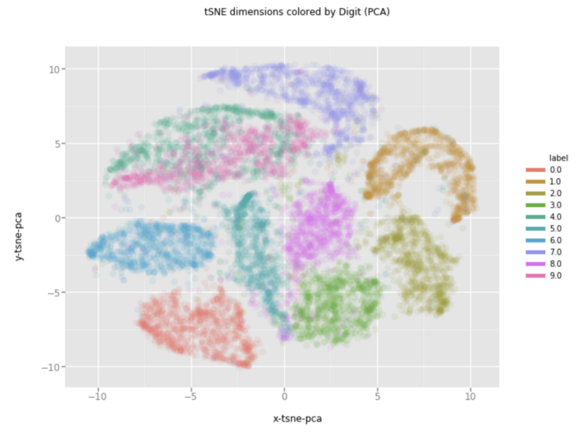
PCA and tSNE application to digits
PCA
tSNE

Slide 28
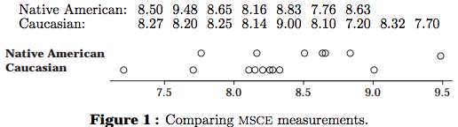
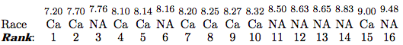
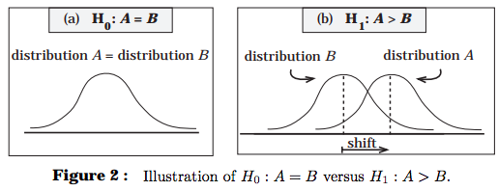
Wilcoxin rank-sum test (Mann Whitney U test)
Rank-based t-test (data is not normally distributed)
Chris Wild, University of Aukalnd
https://www.stat.auckland.ac.nz/~wild/ChanceEnc/Ch10.wilcoxon.pdf

Slide 29
Bonferonni correction for multiple hypothesis testing
If we perform 1000 tests (1000 genes) and accept a p-value < 0.05, how many tests will be incorrect?
Bonferroni correction (very stringent)
Multiply the resulting p-values by the number of tests performed

Slide 30
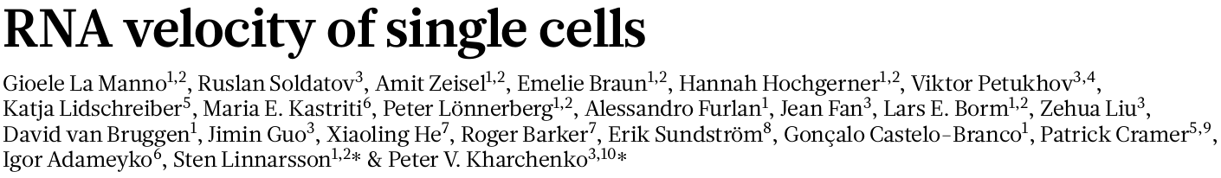
Notes:
In very few words, RNA velocity can track the rate and direction of transcriptomic changes.
When this paper came out there was a ton of hype all over twitter and this was partly because *click*

Slide 31
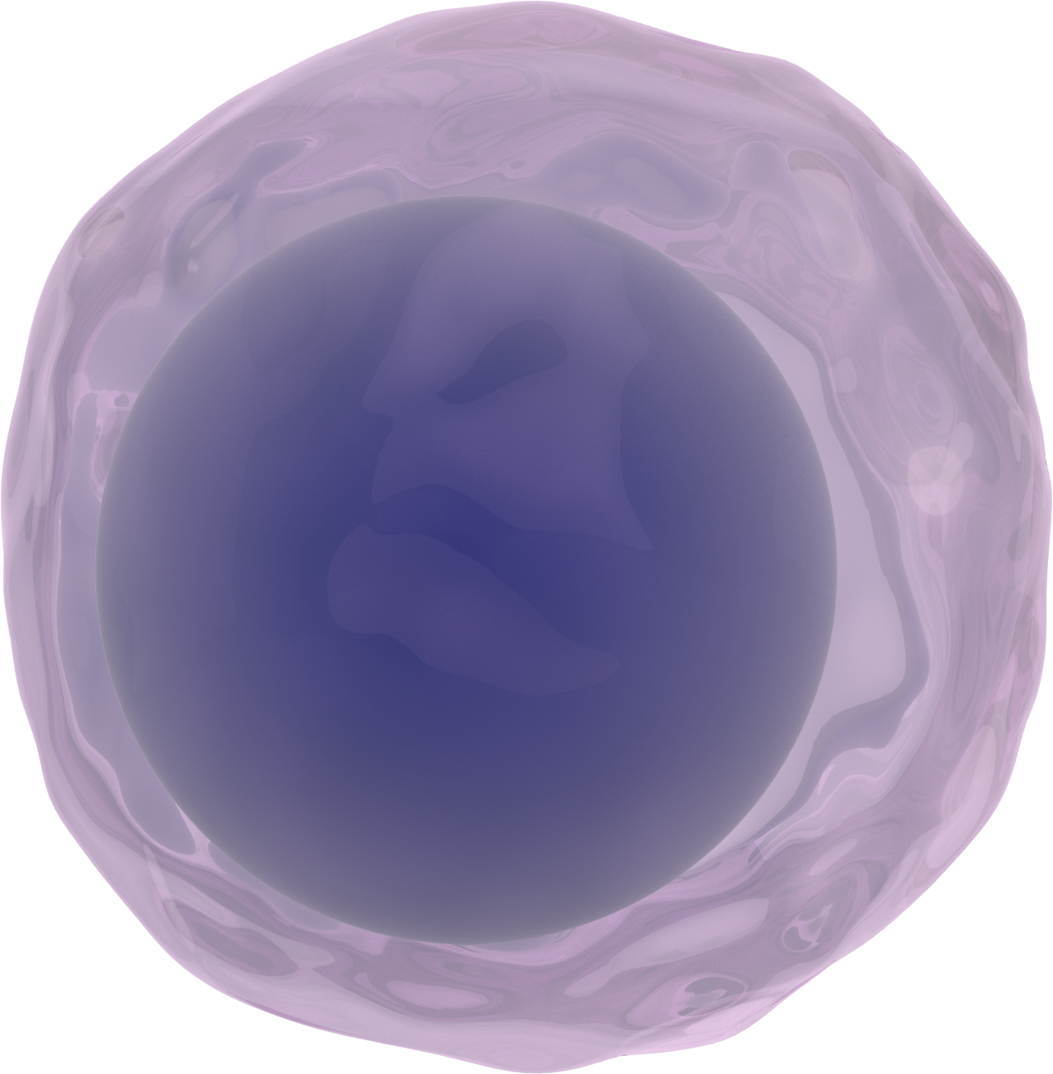
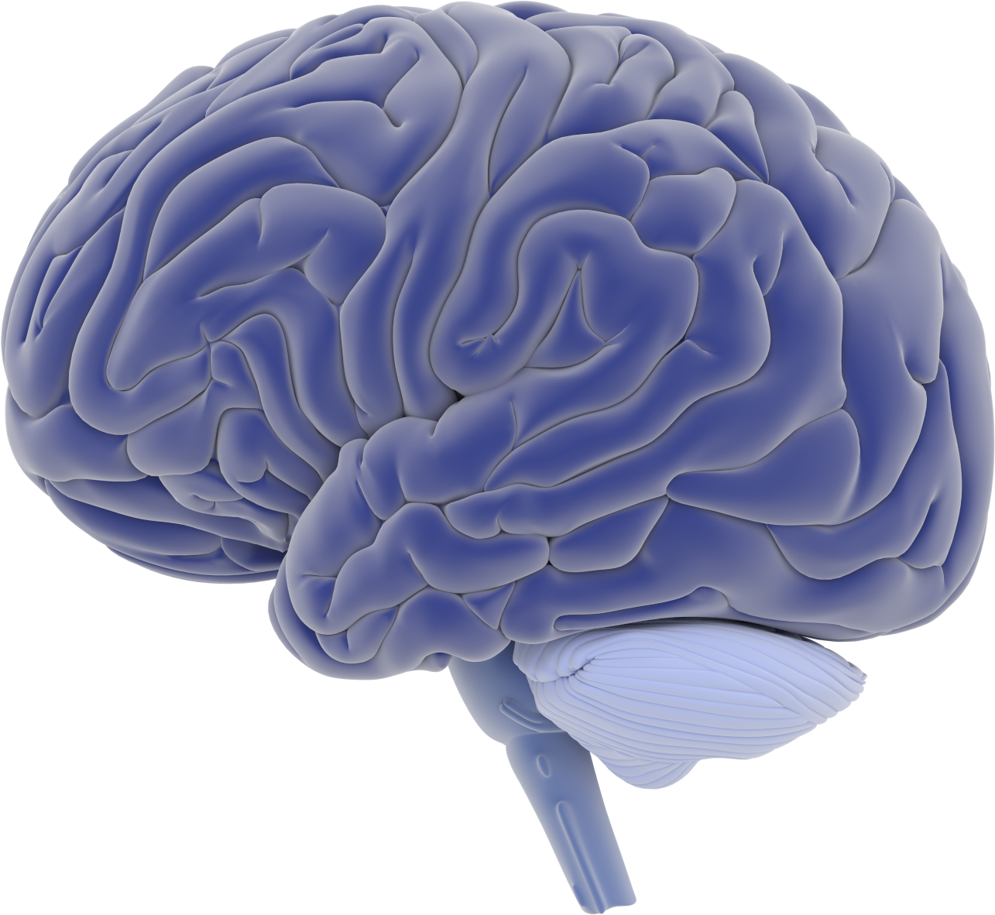

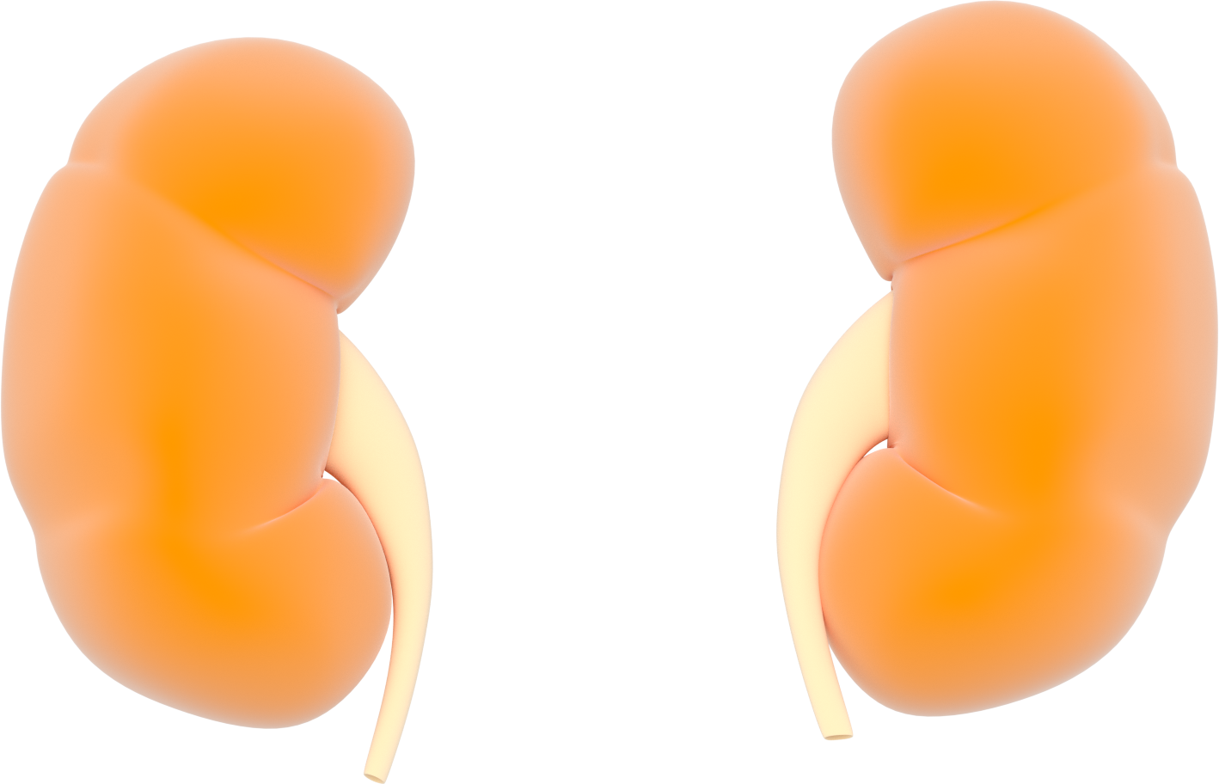
Embryonic Stem Cells
Brain
Lung
Kidney
How can one reconstruct cellular dynamics using static snapshots of the cellular state from single cell RNA-seq (scRNA-seq)?
Notes:
one of the most commonly studied, yet poorly understood processes in biology is development. So how exactly single cells form complex tissues such as the brain, the lung, the kidney, and eventually entire organisms.
Studying development is hard. It typically requires and combines methods from different fields. but one of the major accomplishments in the last few years has been the development of single cell RNA sequencing assays that reveal RNA abundance with high quantitative accuracy and sensitivity. However, like bulk RNA-seq, single cell RNA-sequencing only captures a static snapshot at a single point in time, which makes the analysis of time-resolved phenomena such as development a challenge.
So the major question that our paper is trying to answer is *click* .. (question).

Slide 32
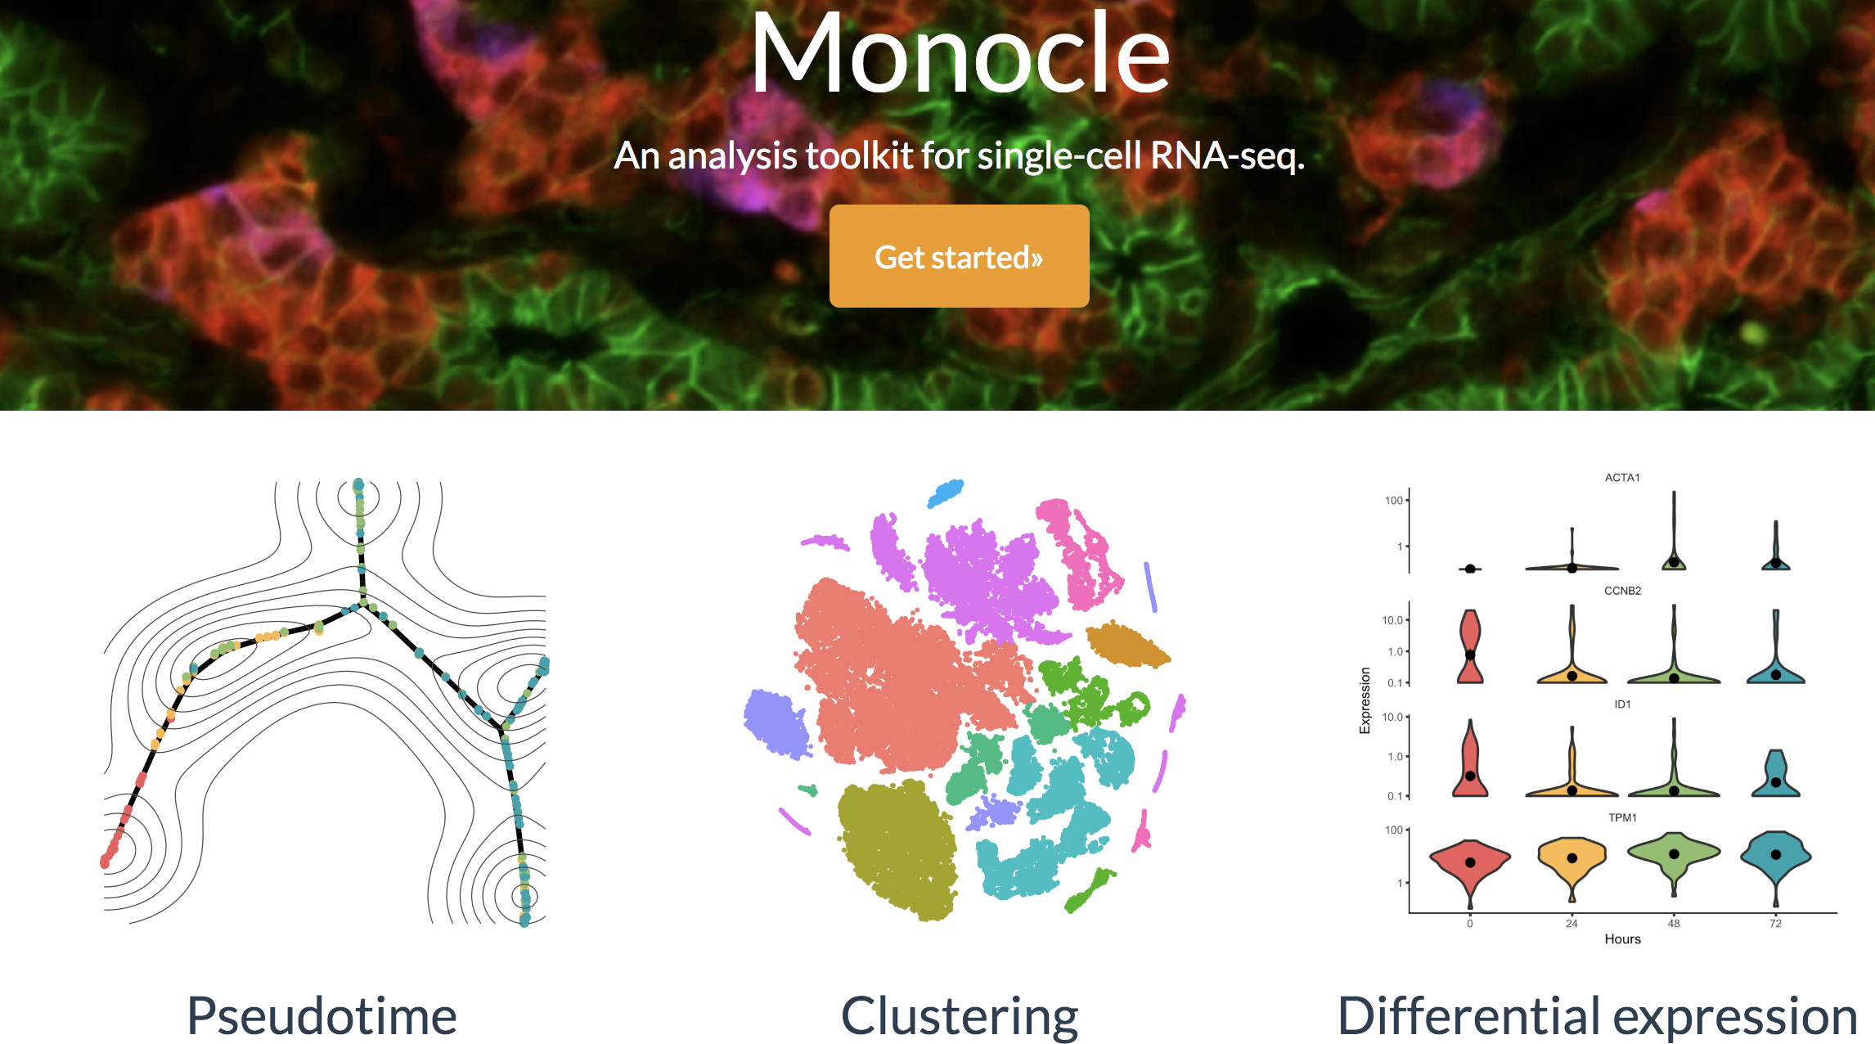
Notes:
There has been great progress in answering this question, especially in methods development
There are several existing tools available to infer cell lineage and expression dynamics from scRNA-seq such as Monocle. The tool that invented this idea of “Pseduotime” which measures how much progress an individual cell has made through a process such as cellular differentation. However existing methods require assumptions about start and end points and do not indicate the direction the cells are traveling.
In our paper, the authors argue that *click* that the relative abundance of unspliced (or nascent) and spliced (or mature) mRNA can be used to reveal the rate and direction of transcriptomic changes.
*DO NOT NEED TO READ* Pseudotime is a measure of how much progress an individual cell has made through a process such as cell differentiation.
Pseudotime is an abstract unit of progress: it's simply the distance between a cell and the start of the trajectory, measured along the shortest path. The trajectory's total length is defined in terms of the total amount of transcriptional change that a cell undergoes as it moves from the starting state to the end state.

Slide 33
The relative abundance of unspliced (nascent) and spliced (mature) mRNA can be used to reveal the rate and direction of transcriptomic changes
Notes:
the relative abundance of unspliced (or nascent) and spliced (or mature) mRNA can be used to reveal the rate and direction of transcriptomic changes.

Slide 34
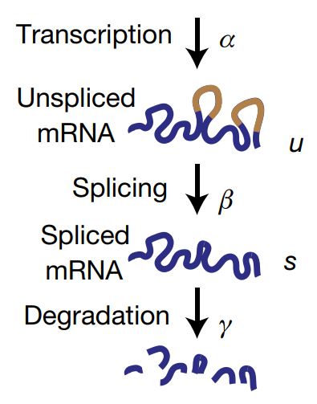
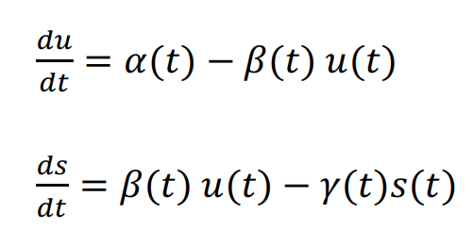
Unspliced/Spliced model

Slide 35
Unspliced/Spliced model

Slide 36
Unspliced/Spliced model

Slide 37
Unspliced/Spliced model

Slide 38
Assumption: Time independent transcription, splicing, and degradation rates
Step Function
Constants

Slide 39
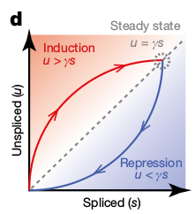
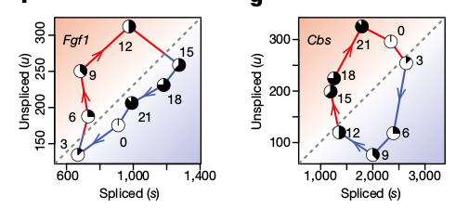
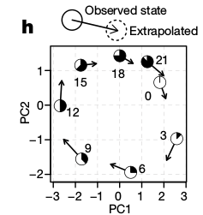
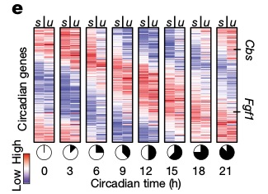
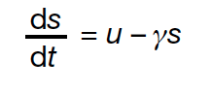
Circadian Cycle in Mouse Liver Demonstrates Model
Proposed Model
Spliced and Unspliced mRNA Levels
Applied Model
Predictive Model
Solving differential equation of each gene allows prediction of the expected direction of progression of the circadian cycle
Circadian-associated genes (Fgf1 and Cbs) show excess of unspliced mRNA in upregulation and deficit in downregulation
Notes:
D. Solving the proposed differential equations for each gene allows us to extrapolate each measurements though the circadian cycle, accurately capturing the expected direction of progression of the circadian cycle.
Change in expression state at a future time t, as predicted by the model, is shown in the space of the first two principal components (PCs), recapitulating the progression along the circadian cycle. Each circle shows the observed expression state, with the arrow pointing to the position of the future state, extrapolated from velocity estimates.

Slide 40
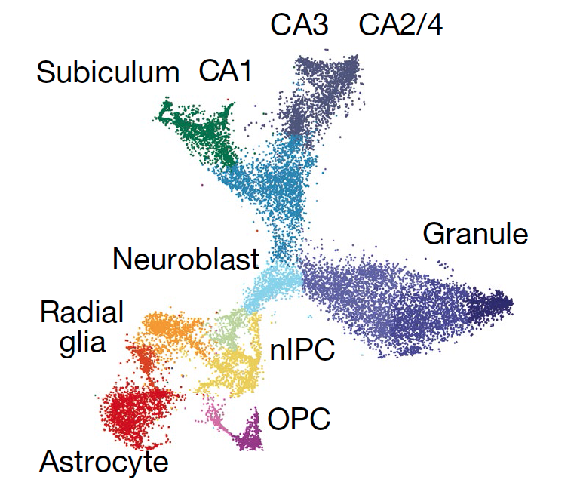
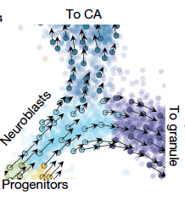
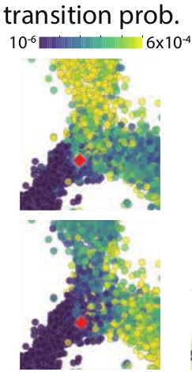
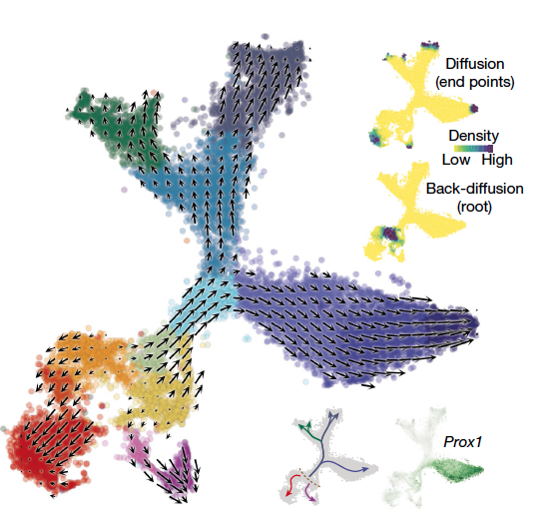
Fate Decisions of Major Neural Lineages
1
3
t-SNE
2
RNA Velocity can orient a lineage tree without prior knowledge of the developmental process
Notes:
The two adjacent cells at the entrance of the branching point between the CA and granule fates in red show that although their current state showed that they were neighbors, their futures were already tilted toward different fates as shown by looking at the transition probabilities from the two starting cells to neighboring cells.

Slide 41
Conclusions
Issues
Reveals temporal dynamics of single-cell gene expression on a timescale of hours
Matches the unfolding of developmental, regenerative and reactive processes in both human and other mammals
Can be used to model commitment, fate choice and precise kinetics of transcription in vivo
Can be used to estimate cellular state 2.5-3.8 hours into the future
Doesn’t work on some models of differentiation (such as in vitro differentiation, which is over several weeks)
The exact time-points of when you take your samples becomes incredibly important
Genetic variation within sampling
Notes:
extrapolate 2.5 to 3.8 hours into the future and that the spliced/unspliced ratio is detectable after 10-100 min

Slide 42
PAGA (Partition-based graph abstraction)
Current computational approaches for scRNA-seq:
Clustering: assumes that data is composed of biologically distinct groups such as discrete cell types or states and labels these with a discrete variable
Inferring pseudotemporal orderings or trajectories of cells: assumes that data lie on a connected manifold and labels cells with a continuous variable
PAGA is a statistical model for the connectivity of groups of cells whose nodes correspond to cell groups and whose edge weights quantify the connectivity between groups. Groups are connected if their number of inter-edges exceeds a fraction of the number of inter-edges expected under random assignment.
By quantifying the connectivity of partitions (groups, clusters) of the single-cell graph, PAGA generates a much simpler abstracted graph (PAGA graph) of partitions
By averaging over single-cell paths, it becomes possible to trace a putative biological process from a progenitor to fates

Slide 43

Partition-based graph abstraction (PAGA)
PAGA generates graph-like maps of cells that preserve both the continuous and disconnected structure in single cell mRNA-seq data, reconciling clustering and pseudotemporal ordering algorithms
F. A. Wolf et al., Graph abstraction reconciles clustering with trajectory inference through a topology preserving map of single cells. bioRxiv 208819 [Preprint]. 25 October 2017.
Notes:
Starting from the neighborhood graph of single cells, in which cells are represented as nodes, the algorithm quantifies the connectivity of cell clusters and generates a much simpler abstracted graph in which nodes correspond to the clusters identified by a clustering algorithm of your choice and edges represent putative transitions between clusters. The differentiation tree is then computed as the treelike subgraph in the abstracted graph that best explains all continuous progressions along the original single-cell graph. The statistical model considers groups as connected if their number of inter-edges exceeds a fraction of the number of inter-edges expected under random assignment. The connection strength can be interpreted as confidence in the presence of an actual connection and allows discarding spurious, noise-related connections.
High-dimensional gene expression data is represented as a kNN graph by choosing a suitable representation and an associated distance metric for computing neighborhood relations. The kNN graph is partitioned at a desired resolution — partitions represent groups of connected cells. A PAGA graph is obtained by associating a node with each partition, which are connected by weighted edges that represent the statistically estimated connectivity of partitions. By discarding spurious edges with low weights, PAGA graphs reveal the denoised topology of the data at a chosen resolution and reveal its connected and disconnected regions. Combining high-confidence paths in the PAGA graph with a random-walk based distance measure on the single-cell graph, we order cells within each partition according to their distance from a root cell. A PAGA path then averages all single-cell paths that pass through the corresponding groups of cells. This allows to trace gene expression changes along complex trajectories at single-cell resolution.
A PAGA graph whose nodes correspond to cell groups and whose edge weights quantify the connectivity between groups.

